Slide 1
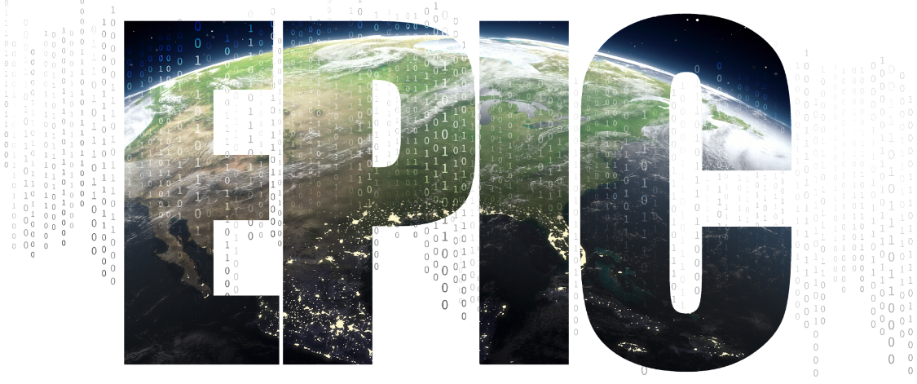



EPIC GitHub Tutorial (Part 2):
Contributing to UFS/EPIC Repositories
Natalie Perlin, NOAA/EPIC, natalie.perlin@noaa.gov
https://github.com/NOAA-EPIC/training-github
EARTH PREDICTION INNOVATION CENTER (EPIC)

Slide 2
Welcome!
This is Part 2 of the EPIC GitHub Tutorial on Contributing to UFS/EPIC Repositories
View Part 1: https://epic.noaa.gov/tutorials/?playlist=afde205&video=9e65c0d
All the materials and tutorial presentations (Part 1 and Part 2) could be found at https://github.com/NOAA-EPIC/training-github
Get all the materials and tutorial presentations (Part 1, Part 2):
git clone https://github.com/NOAA-EPIC/training-github.git cd ./training-github
The directory ./training-github/ will contain all of the materials for the tutorial.
EARTH PREDICTION INNOVATION CENTER (EPIC)
Notes:
Please navigate to https://github.com/NOAA-EPIC/training-github
Note this tutorial assumes you are on a Mac or Linux-like system
Complete all prerequisite steps

Slide 3
Recap of the Part 1: Git and GitHub Basics
Basic Git and GitHub terms and concepts introduced
Basic Git configurations and commands discussed
Example given on setting up a SSH key pair for GitHub authentication
A new local repository was created, initialized, pushed to GitHub
Modifications made, committed, local changes tracked, logs viewed
A new branch made, different branches compared
Started topic: public GitHub repositories, forks and clones
EARTH PREDICTION INNOVATION CENTER (EPIC)

Slide 4
GitHub Tutorial Part 2: Working with Remote Repositories
UFS/EPIC Public Repositories, Forks and Clones
Branches and Tags
Git Workflow: from Local Spaces to Remote Repos
Fetching and Merging Remote Branches
Resolve Merge conflicts
Making Pull Requests
GitHub Issues and Discussions
EARTH PREDICTION INNOVATION CENTER (EPIC)

Slide 5
Common GitHub repositories used by UFS community
https://github.com/ufs-community/ufs-weather-model
https://github.com/ufs-community/ufs-srweather-app
https://github.com/ufs-community/land-DA_workflow
https://github.com/ufs-community/uwtools
https://github.com/ufs-community/UFS_UTILS
https://github.com/ufs-community/ccpp-physics (forked from NCAR/ccpp-physics)
https://github.com/hafs-community/HAFS (forked from hafs-communityHAFS)
https://github.com/ufs-community/global-workflow-AR (NOAA-EMC/global-workflow)
https://github.com/NOAA-EMC/UPP
https://github.com/noaa-oar-arl/NEXUS
https://github.com/NOAA-EMC/AQM-utils
https://github.com/JCSDA/spack-stack
EARTH PREDICTION INNOVATION CENTER (EPIC)

Slide 6
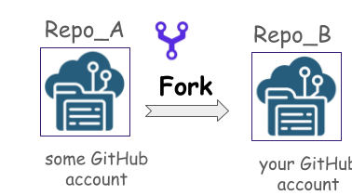
GitHub Repositories: Forks and Clones
fork: a separate copy of another existing repository
created in a remote location, e.g., GitHub account
could be synced with the primary repository
contribute to your fork not affecting the original repo
clone: a linked local copy of an existing repository
a repository code is downloaded to your local machine
done through the command ‘git clone’
references to an original target/remote repository
EARTH PREDICTION INNOVATION CENTER (EPIC)

Slide 7
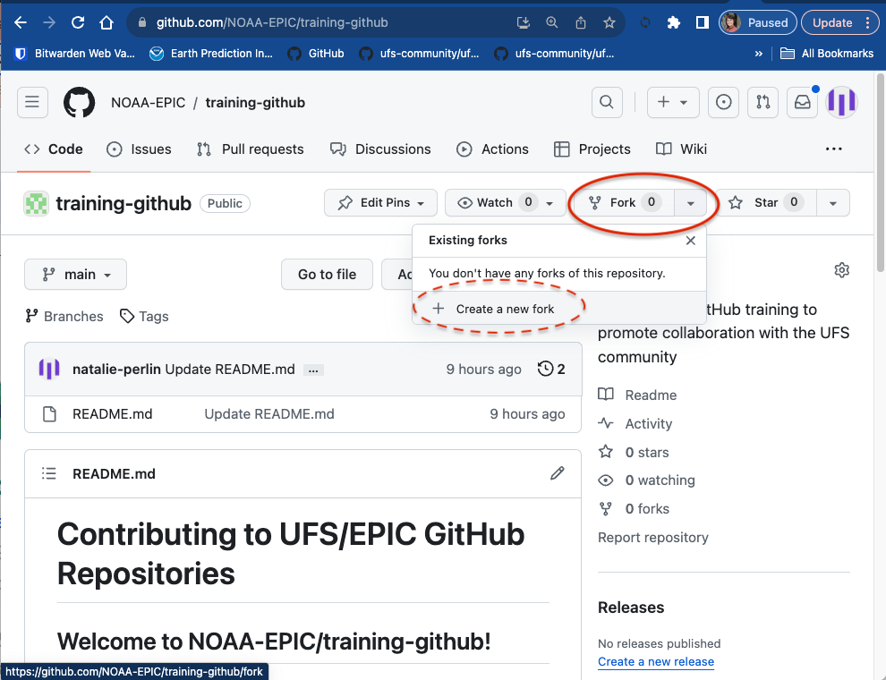
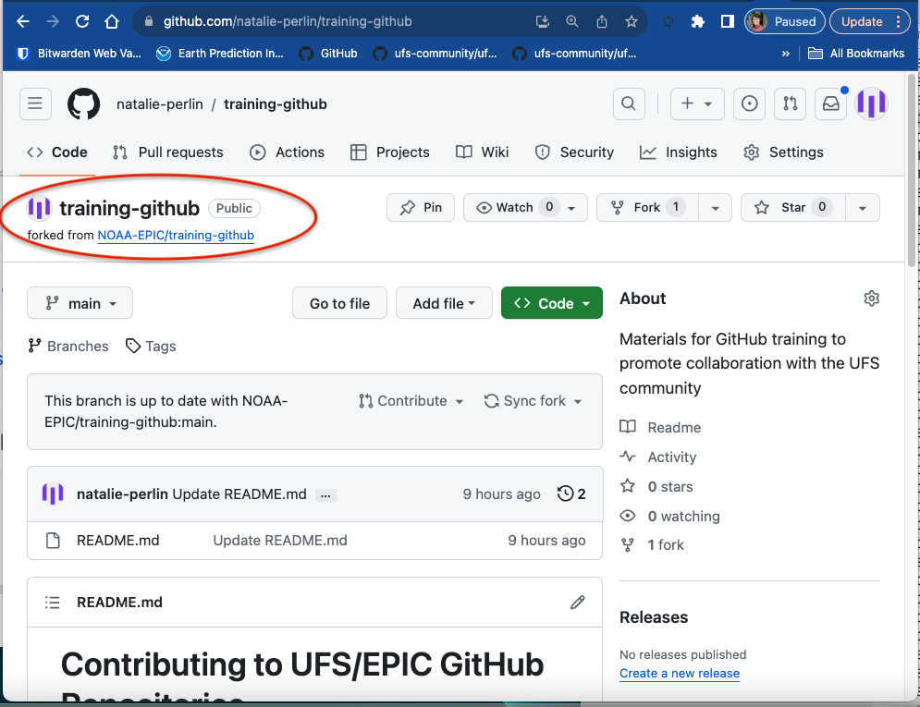
GitHub Repositories: Forks and Clones
fork: a separate copy of another existing repository
created in a remote location, e.g., GitHub account
could be synced with the primary repository
contribute to your fork not affecting the original repo
clone: a linked local copy of an existing repository
a repository code is downloaded to your local machine
done through the command ‘git clone’
references to an original target/remote repository
EARTH PREDICTION INNOVATION CENTER (EPIC)

Slide 8
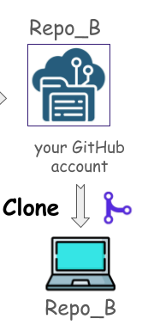
GitHub Repositories: Forks and Clones
fork: a separate copy of another existing repository
created in a remote location, e.g., GitHub account
could be synced with the primary repository
contribute to your fork not affecting the original repo
clone: a linked local copy of an existing repository
a repository code is downloaded to your local machine
done through the command ‘git clone’
references to an original target/remote repository
EARTH PREDICTION INNOVATION CENTER (EPIC)

Slide 9
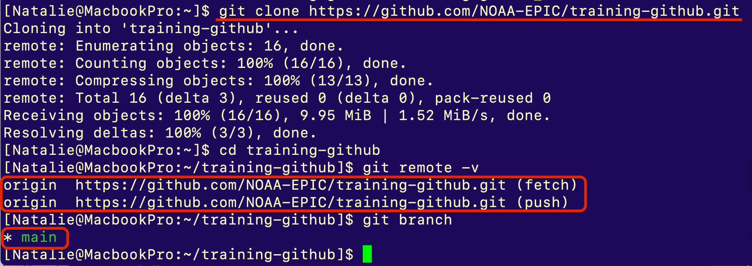
GitHub Repositories: Forks and Clones
fork: a separate copy of another existing repository
created in a remote location, e.g., GitHub account
could be synced with the primary repository
contribute to your fork not affecting the original repo
clone: a linked local copy of an existing repository
a repository code is downloaded to your local machine
done through the command ‘git clone’
references to an original target/remote repository
EARTH PREDICTION INNOVATION CENTER (EPIC)

Slide 10
Contributing to an open-source GitHub repository
FORK the original repository to your GitHub account
CLONE your repository to a local machine
Make changes to your cloned repository
PUSH them to your GitHub repository: it then will be synced to your changes
Create a PULL REQUEST (PR) to merge your changes with the original repository: it means making a request to the repository owner and telling them “Please check my changes and merge them if you like it”
EARTH PREDICTION INNOVATION CENTER (EPIC)

Slide 11




Contributing to an open-source GitHub repository
Repo_A
pull request
Repo_B
fork
your GitHub account
some GitHub account
clone
Repo_B
push
your local system
MAKE CHANGES
EARTH PREDICTION INNOVATION CENTER (EPIC)

Slide 12
GitHub Repositories: Branches and Tags
Branches:
used for concurrent development, bux fixes, implementation features
can be moved or deleted
often expected to be merged back into original branch
feature branches could have a long span
Tags:
mark specific points in history to capture software versions
typically used to mark stable points that correspond to specific releases
permanent and don’t change after they are created
used to label a specific commit
EARTH PREDICTION INNOVATION CENTER (EPIC)
Notes:
Git Branches:
Purpose:
Git branches are used to separate work on features or bug fixes, allowing developers to work on different parts of a project without interfering with each other.
Long-lived development efforts are often done on branches and are expected to be merged back into the main branch upon completion.

Slide 13
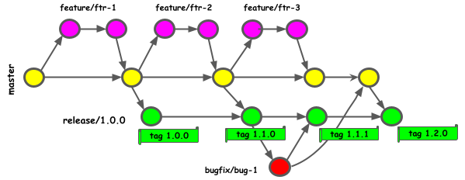
GitHub Repositories: Branches and Tags
feature branch
release branch
tag
bug fix branch
EARTH PREDICTION INNOVATION CENTER (EPIC)

Slide 14
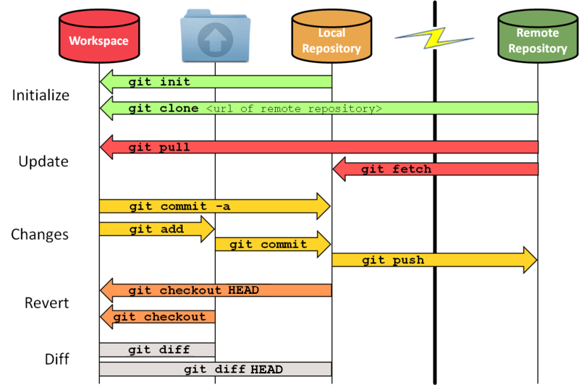
Git workflow: from local spaces to remote repos
Local Git has three stages:
Working area -
your local directory,
all untracked, unstaged,
locally deleted files
Staging area:
what needs to be committed, what
does not need to be committed,
any new files to be added/removed
Local repository (HEAD*):
committed changes,
latest checked out version of the
remote repository
(*) HEAD - symbolic reference to the branch you are working on, or rather, most recent commit
Working
Staging
HEAD(*)
HEAD
index
origin master
origin/master
EARTH PREDICTION INNOVATION CENTER (EPIC)

Slide 15
Git workflow: from local spaces to remote repos
Use an online workflow visualizer tool: https://git-school.github.io/visualizing-git:
case 1: divergent local branches, merge, update the remote repo
case 2: divergent local branches, detached HEAD, rebase, merge, bring upstream branch changes, update the remote repo
Use an existing authoritative repository to test real-case scenarios
fetch and merge remote branches, update a fork repository
introduce your changes, merge, resolve merge conflicts
make a pull request (PR) into the authoritative repository
Test out a PR, give feedback, make a PR into another developer’s code
EARTH PREDICTION INNOVATION CENTER (EPIC)

Slide 16
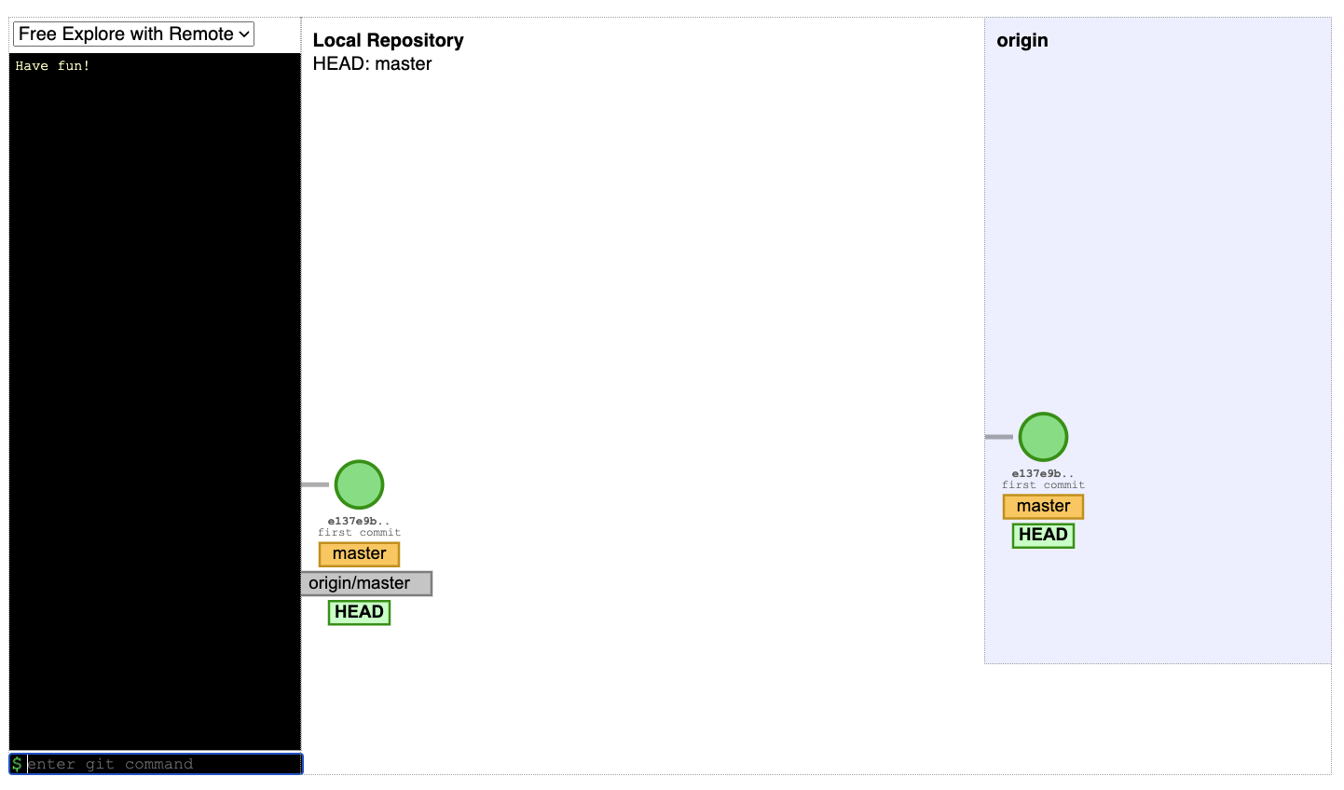
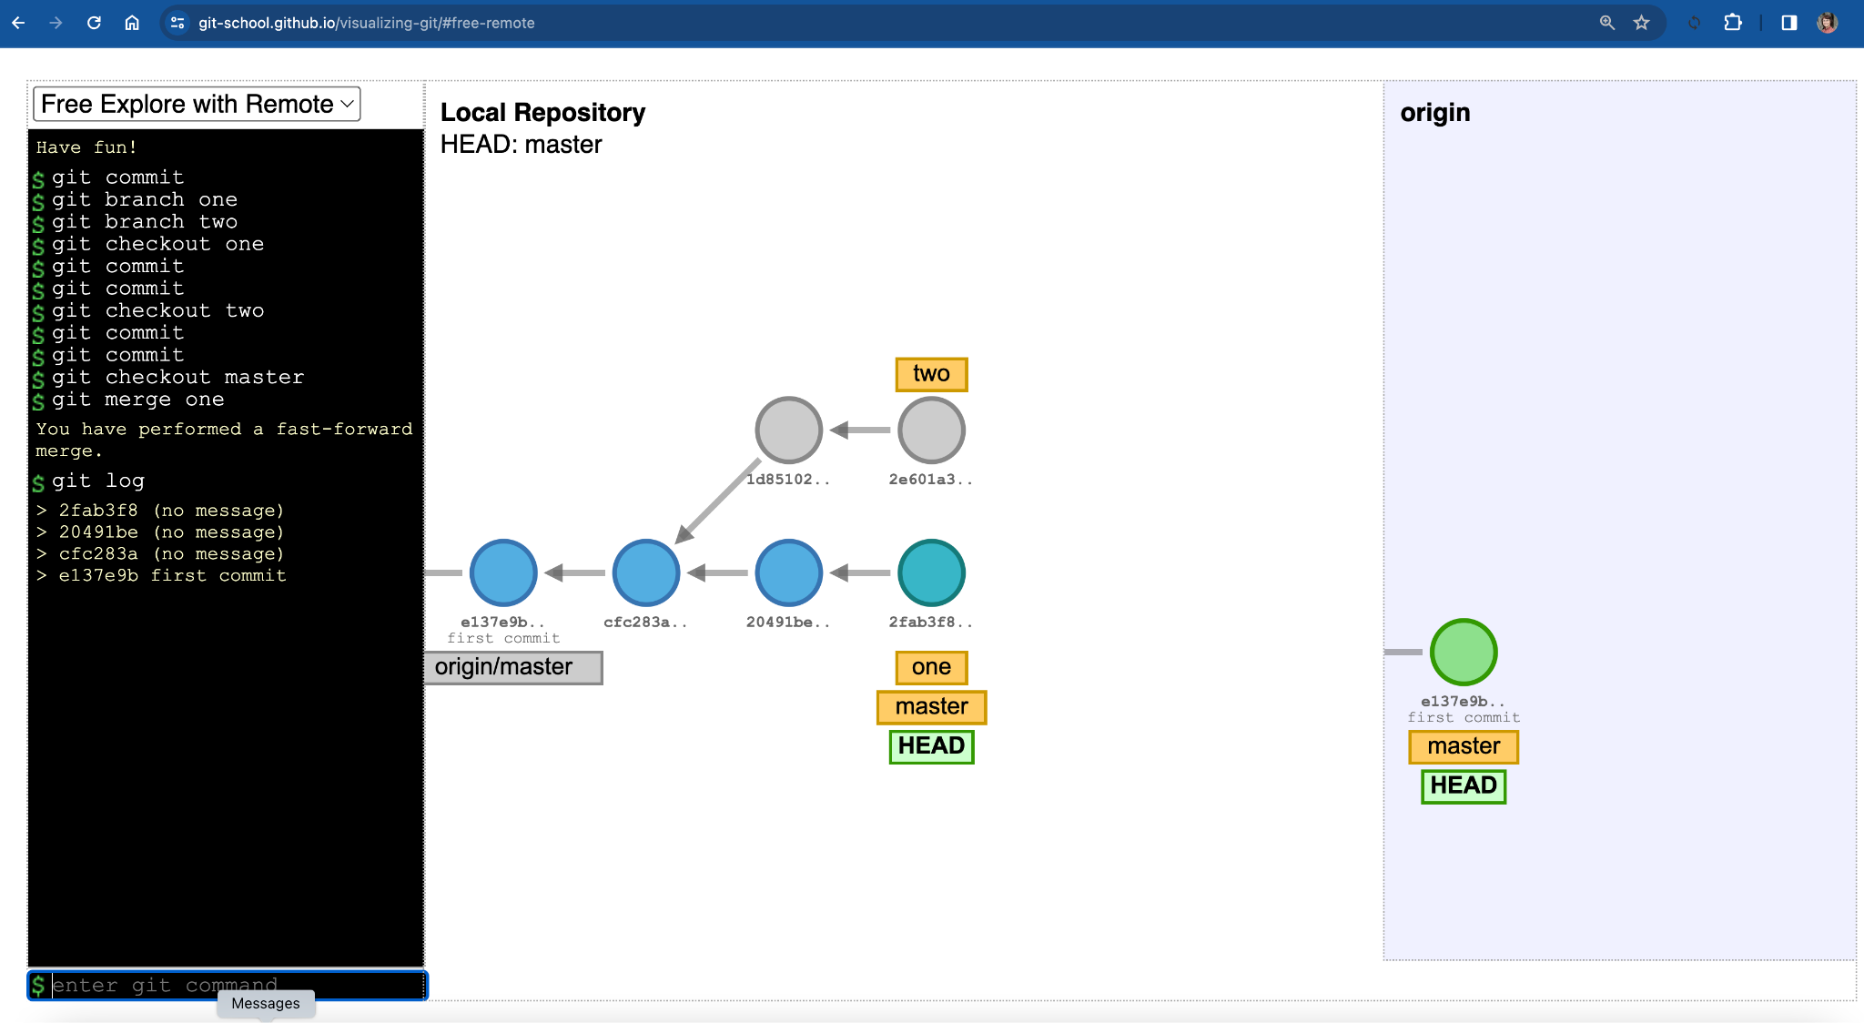
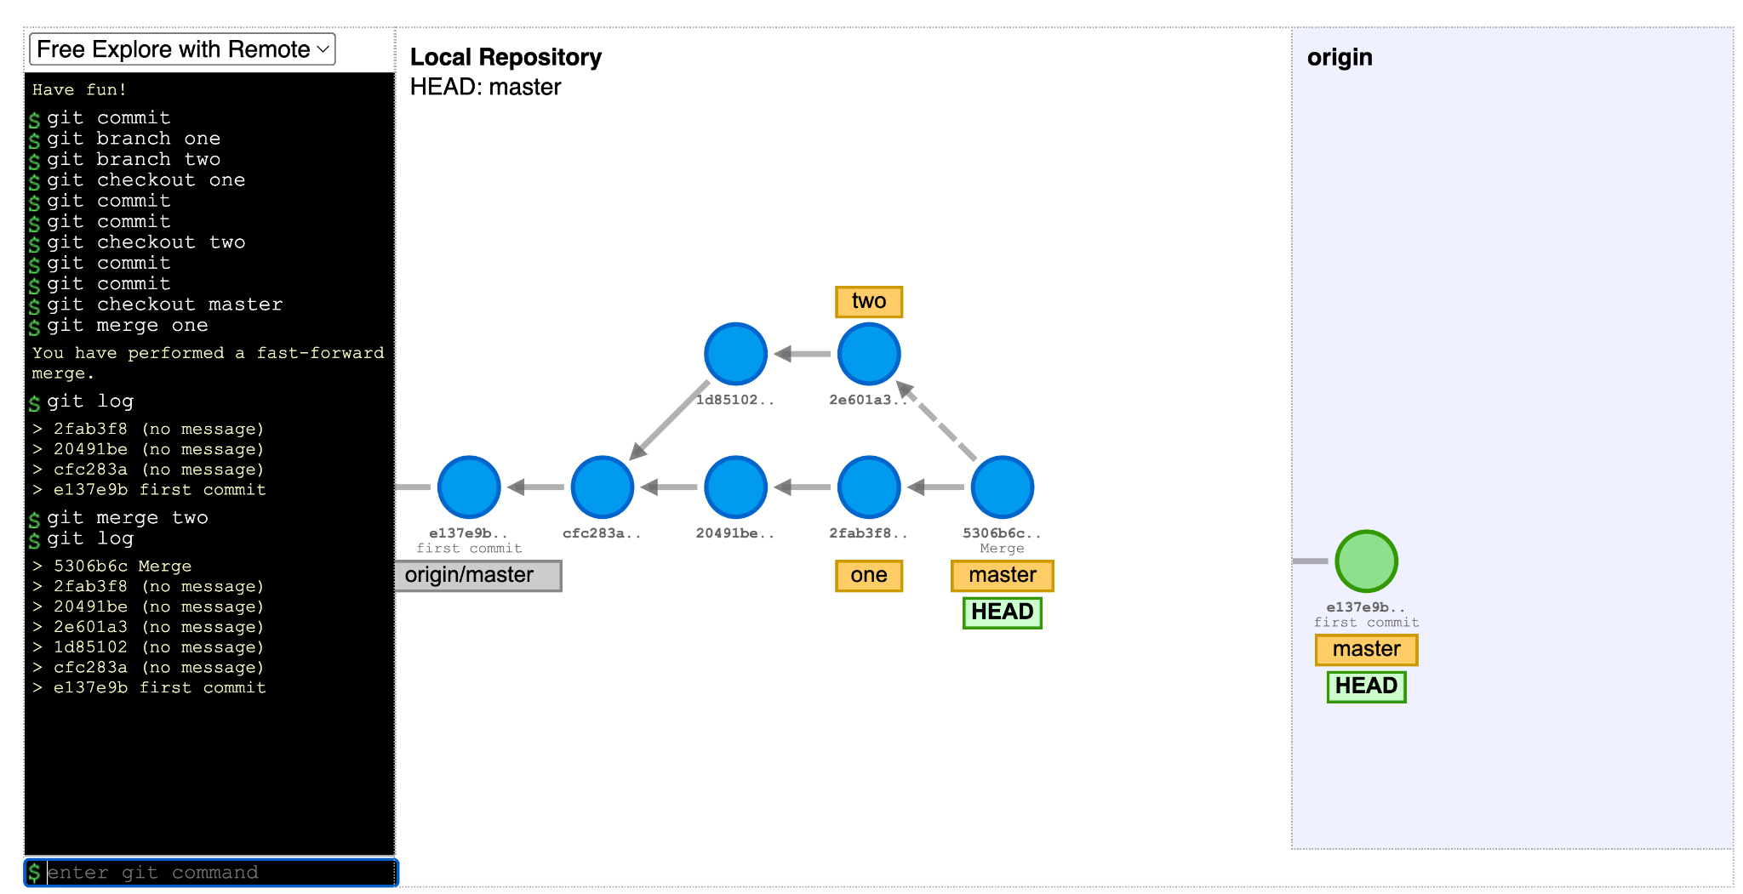
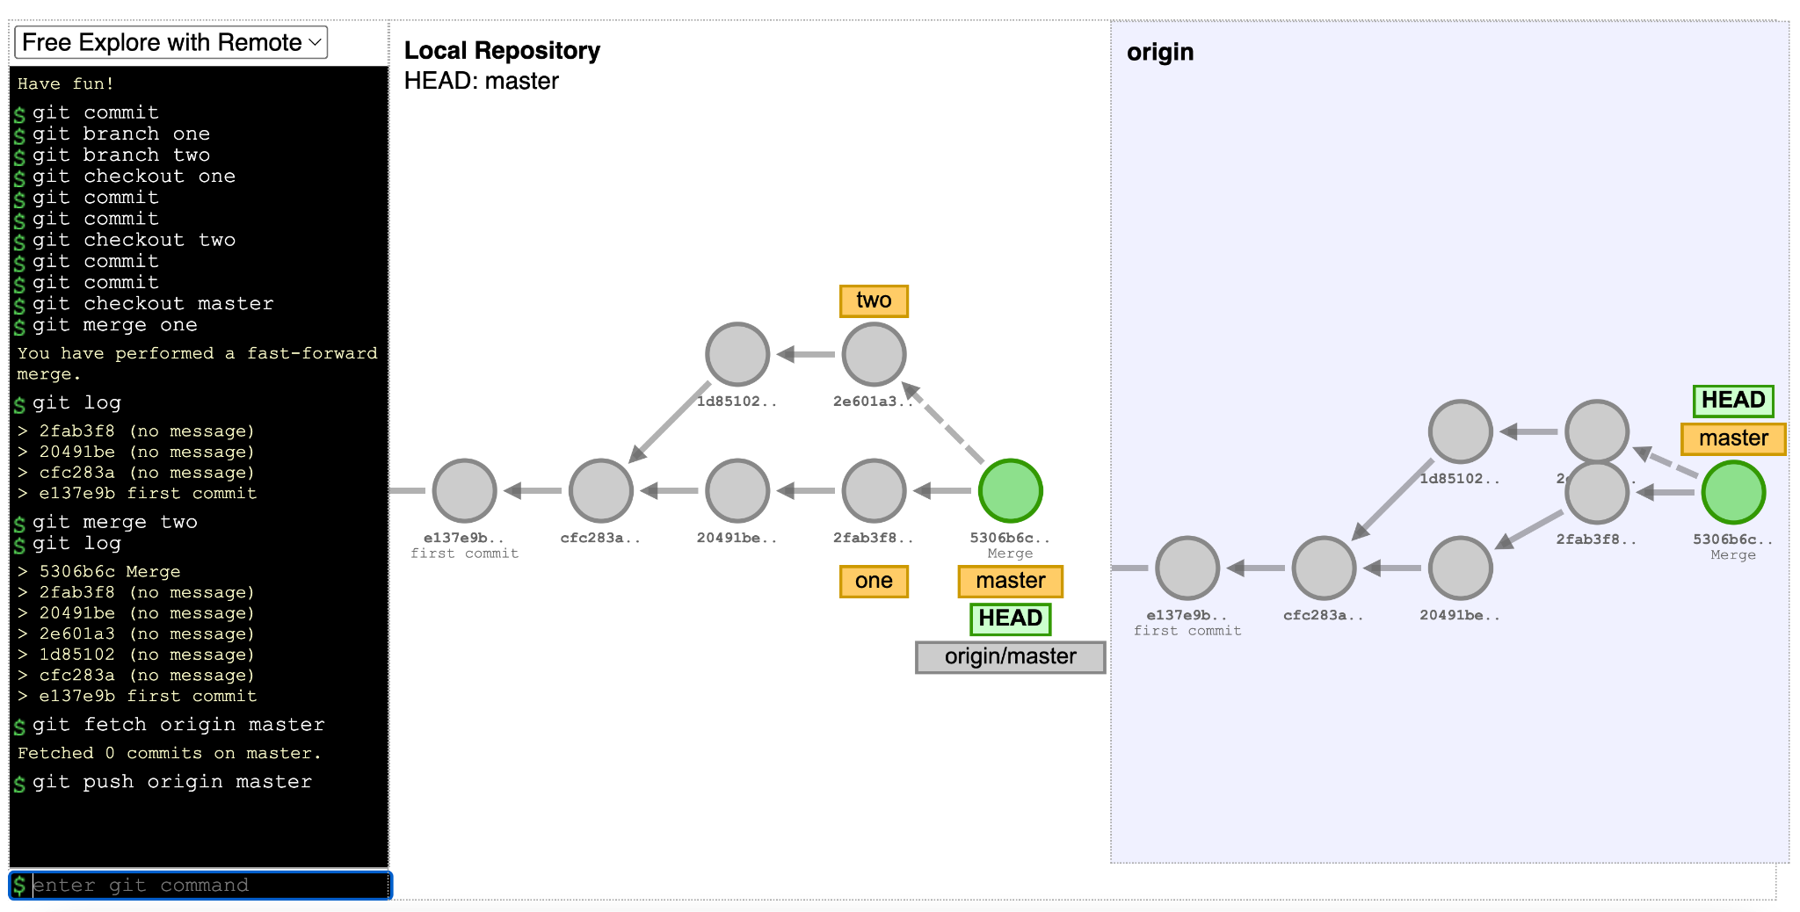
Visualization cases: case 1 (https://git-school.github.io/visualizing-git)
case 1: divergent local branches, merge, update the remote repo
EARTH PREDICTION INNOVATION CENTER (EPIC)

Slide 17
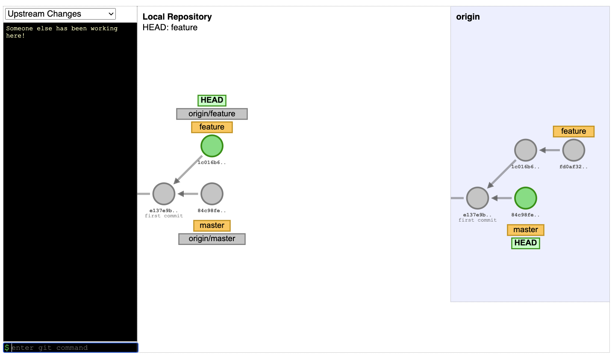
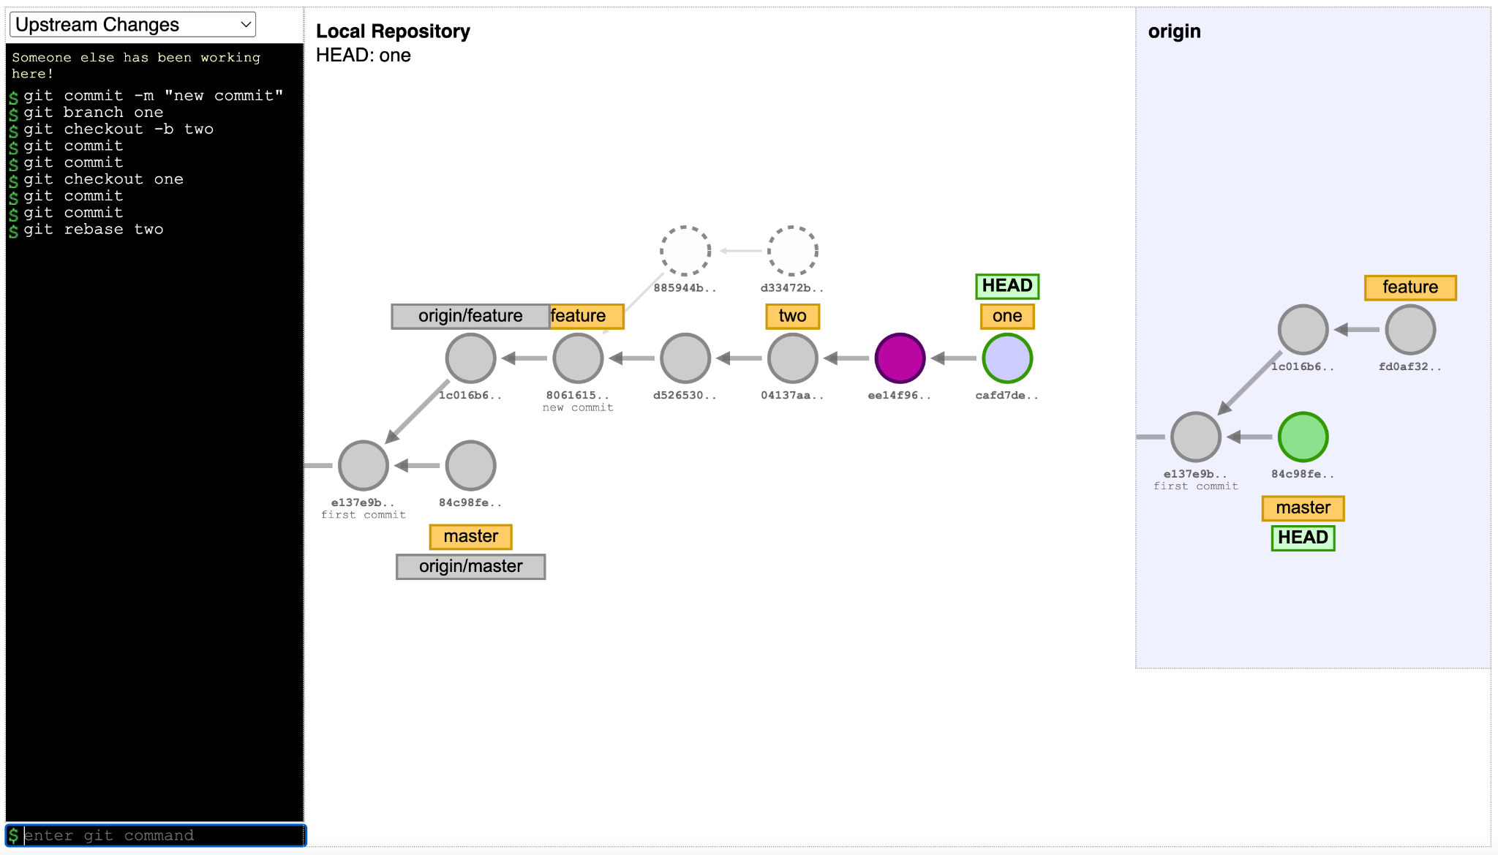
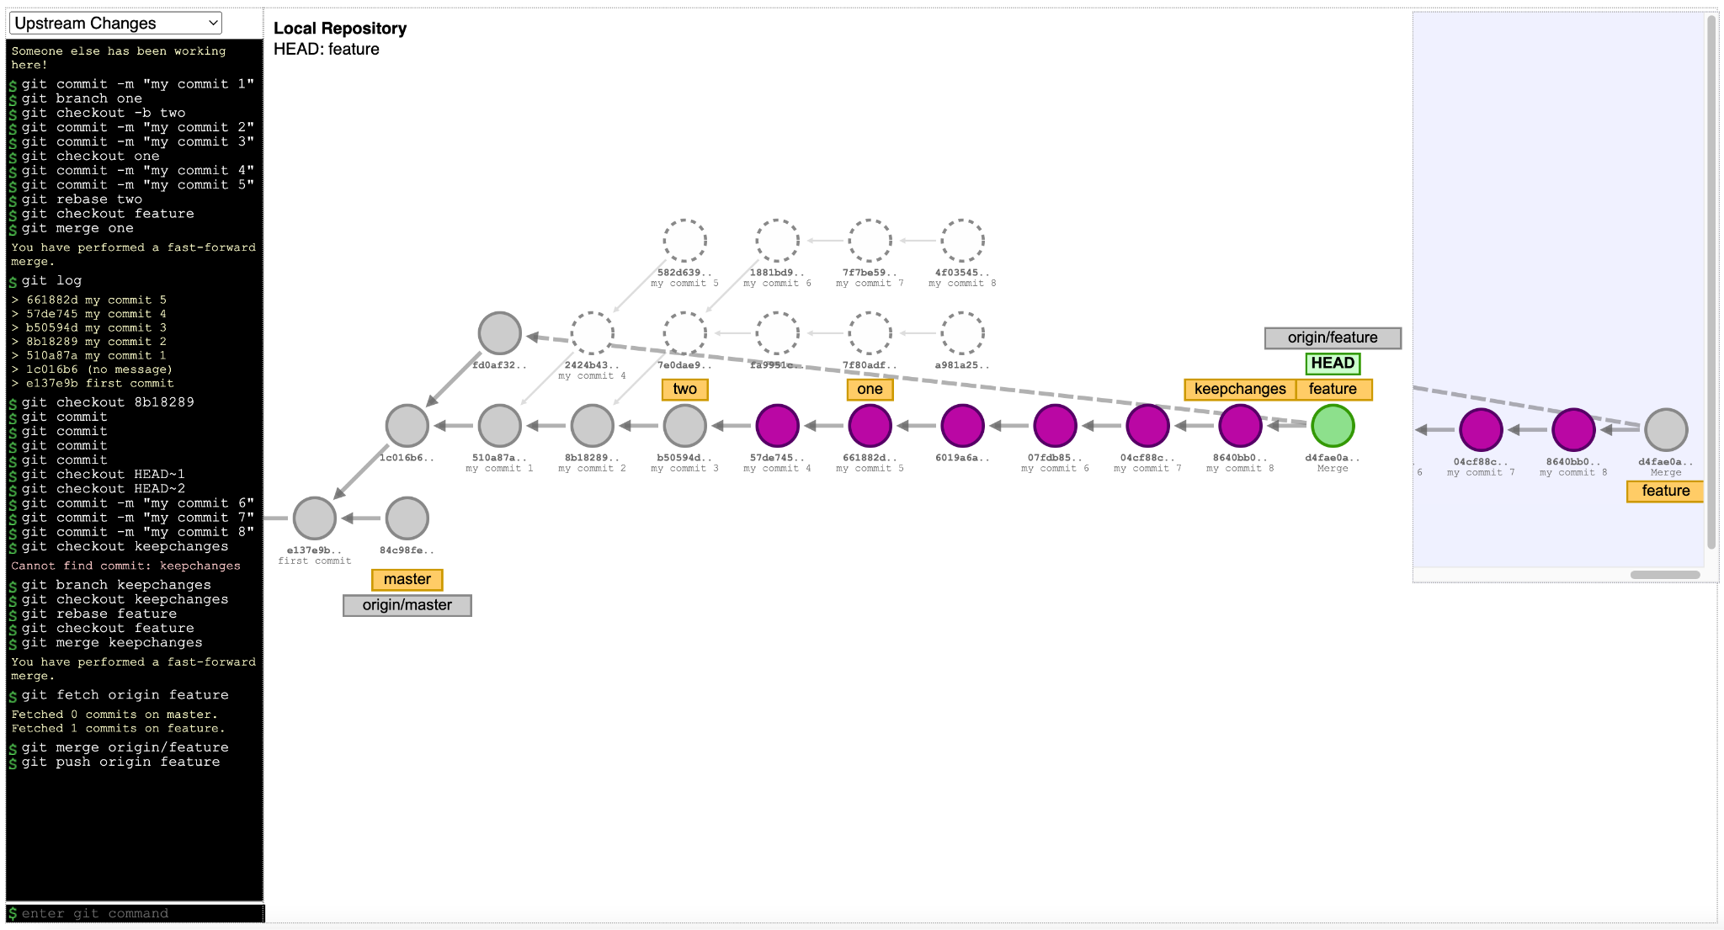
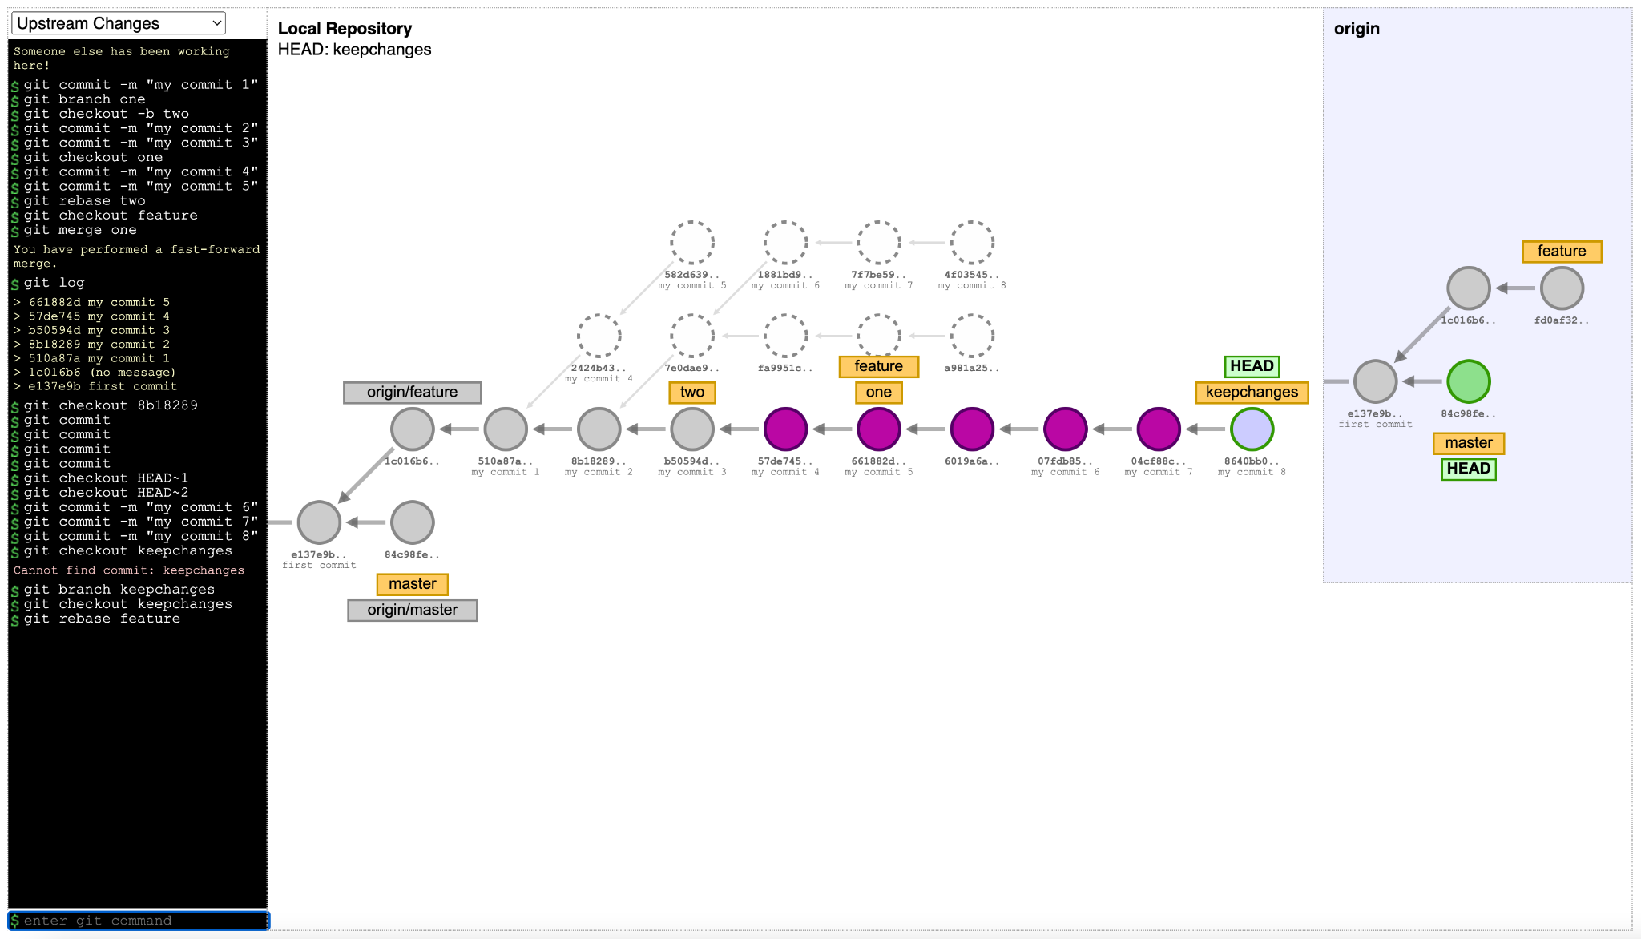
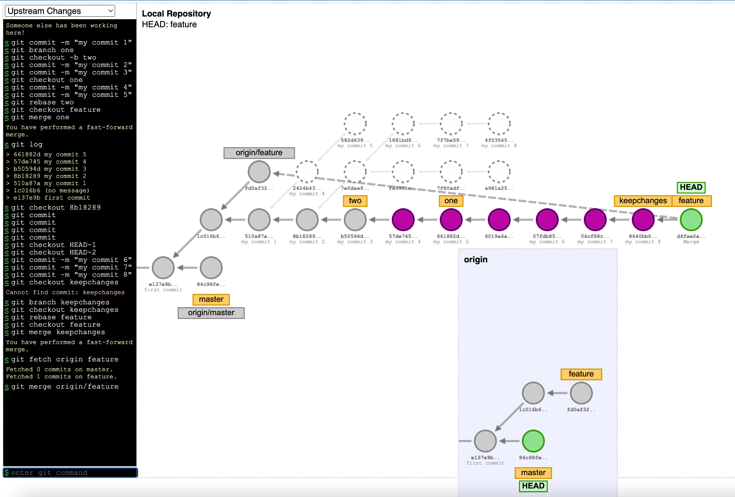
Visualization cases: case 2 (https://git-school.github.io/visualizing-git)
case 2: divergent local branches, rebase, detached HEAD, merge, bring upstream branch changes, update the remote repo
EARTH PREDICTION INNOVATION CENTER (EPIC)

Slide 18
Steps to contribute to public remote repositories
Create a fork of the authoritative repo in your GitHub account (dashboard)
Clone the fork repository to your local machine
git clone git@github.com<your-fork-repo>
Add the authoritative repository for the reference and updates
git remote add upstream <url-of-the-authoritative-repo>
Checkout a branch to make changes: git checkout master
MAKE CHANGES, MAKE A DIFFERENCE!
Fetch any changes from the authoritative repository:
git fetch upstream master
Merge changes from the updated remote reference into the your branch
git merge upstream/master
Push your changes back to your fork on GitHub: git push origin master
Create a pull request (PR) into the authoritative repository (dashboard)
EARTH PREDICTION INNOVATION CENTER (EPIC)

Slide 19
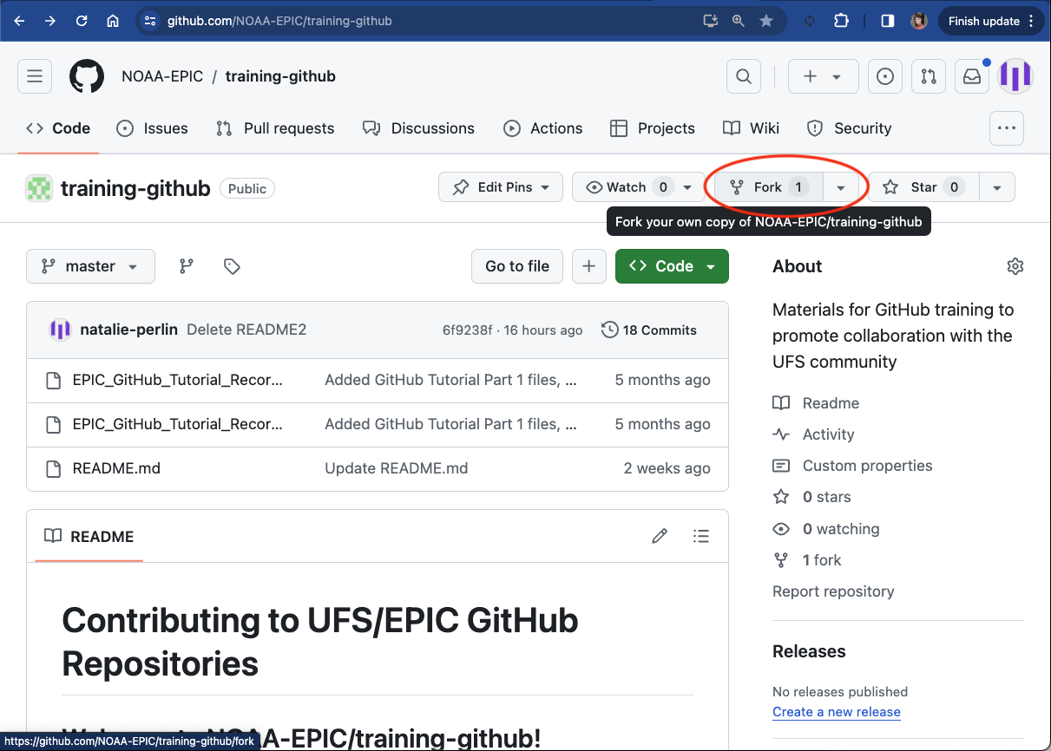
Git workflow example with an existing authoritative repo
An existing repository: https://github.com/NOAA-EPIC/training-github
fetch and merge remote branches, update a fork repository
git clone git@github.com:<repo-fork>
cd <training-github>
git remote add upstream <authoritative-repo>
git remote -v
git checkout master
# make changes, commit them to a master branch
# fetch any updates from the authoritative repository:
git fetch upstream
git merge upstream/master
git log --oneline
git push origin master
EARTH PREDICTION INNOVATION CENTER (EPIC)

Slide 20
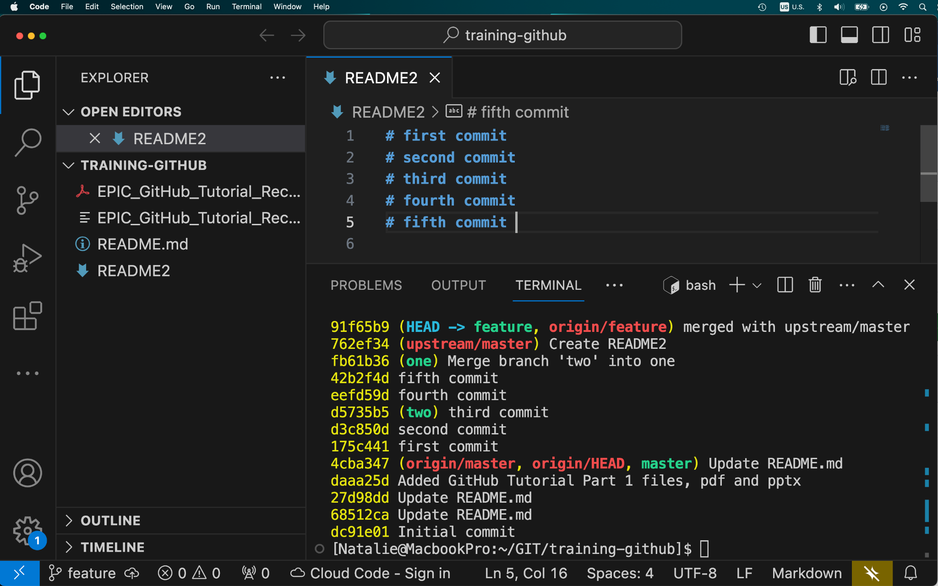
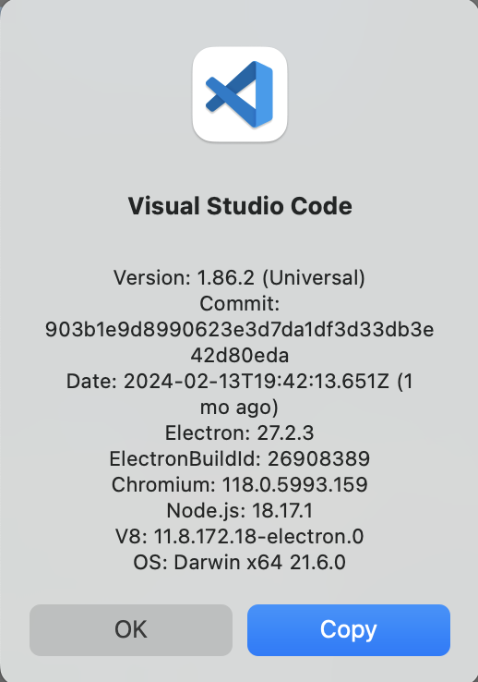
Git workflow example with an existing authoritative repo
We could use a GUI code editor, such as Visual Studio Code
EARTH PREDICTION INNOVATION CENTER (EPIC)

Slide 21
Git workflow example 2 with an existing authoritative repo
An existing authoritative repository: https://github.com/NOAA-EPIC/training-github
introduce your changes, merge, resolve merge conflicts
git clone git@github.com:<repo-fork>
git remote add upstream <authoritative-repo>
git remote -v
git checkout master
git checkout -b feature
# create a file README2, line: # first commit
git add README2
git commit -m “first commit”
git branch one
git checkout -b two
EARTH PREDICTION INNOVATION CENTER (EPIC)

Slide 22
Git workflow example 2 (continued)
An existing authoritative repository: https://github.com/NOAA-EPIC/training-github
introduce your changes, merge, resolve merge conflicts
git branch
# Add a line to README2 file: # second commit
git commit -am “second commit”
# Add a line to README2 file: # third commit
git commit -am “third commit”
git checkout one
# Add a line to README2 file: # fourth commit
git commit -am “fourth commit”
# Add a line to README2 file: # fifth commit
git commit -am “fifth commit”
git branch
git merge two
# solve merge conflicts using a text editor!!
git commit -am “merge with two”
git branch
git checkout feature
git merge one
git log --oneline
git fetch upstream master
git merge upstream/master
git checkout upstream/master
git commit -am “merge with upstream”
git push origin feature
EARTH PREDICTION INNOVATION CENTER (EPIC)

Slide 23
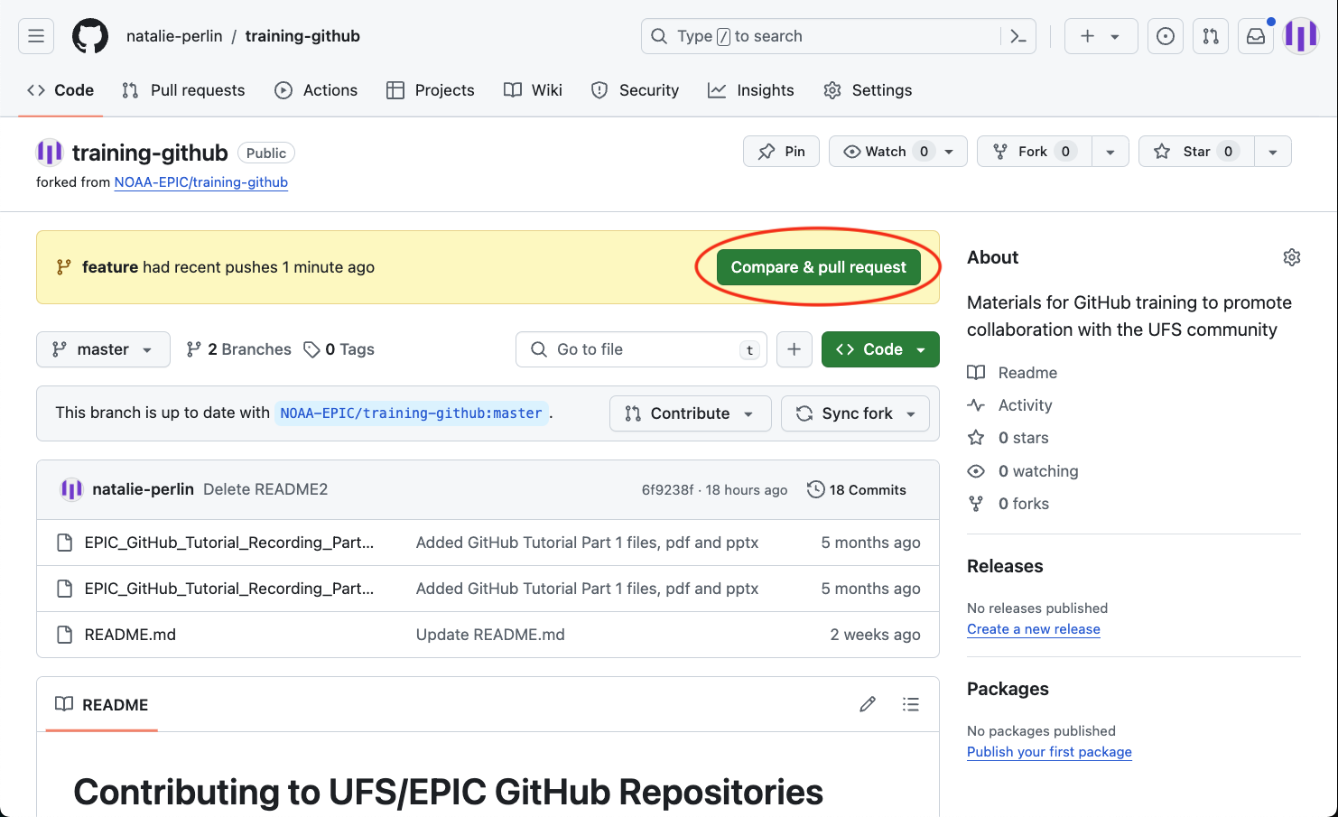
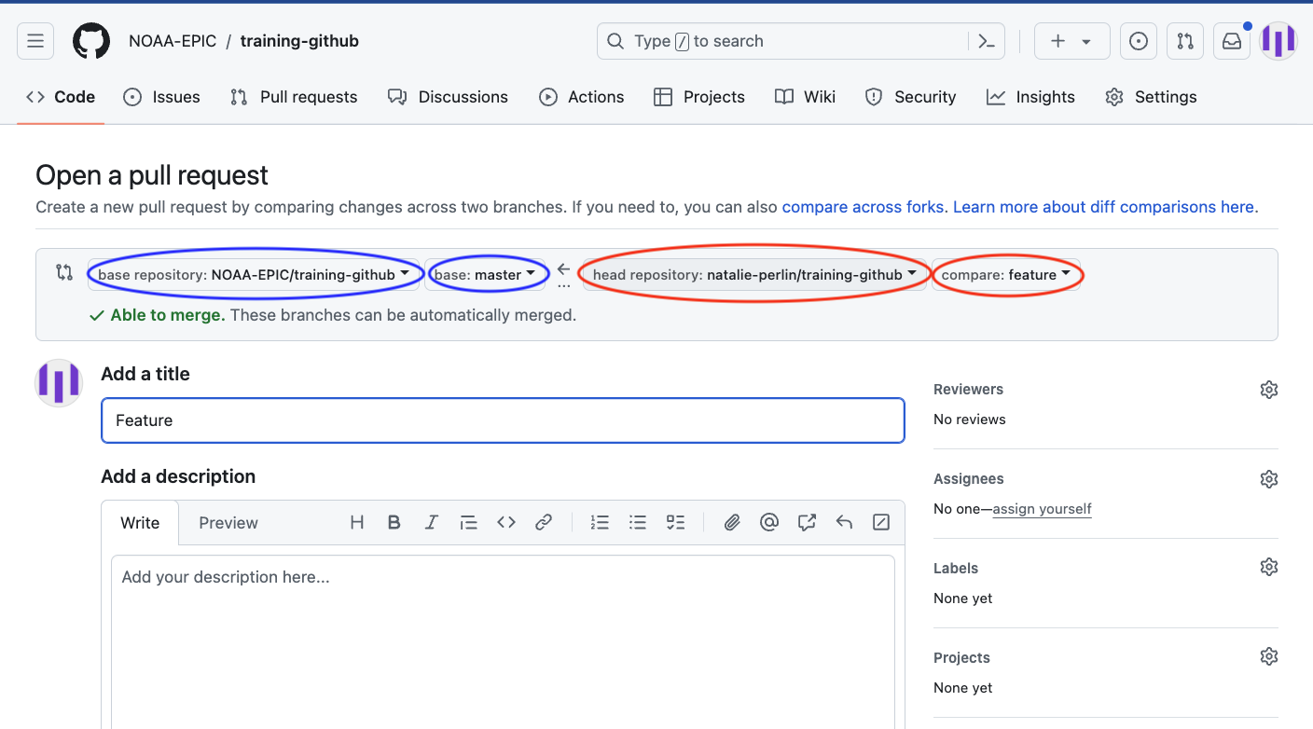
Git workflow example: submit a pull request
An existing authoritative repository: https://github.com/NOAA-EPIC/training-github
make a pull request (PR) into the authoritative repository (*)
(*) - you may need to address any comments, resolve conversations, complete requested changes by PR Reviewers!
EARTH PREDICTION INNOVATION CENTER (EPIC)

Slide 24
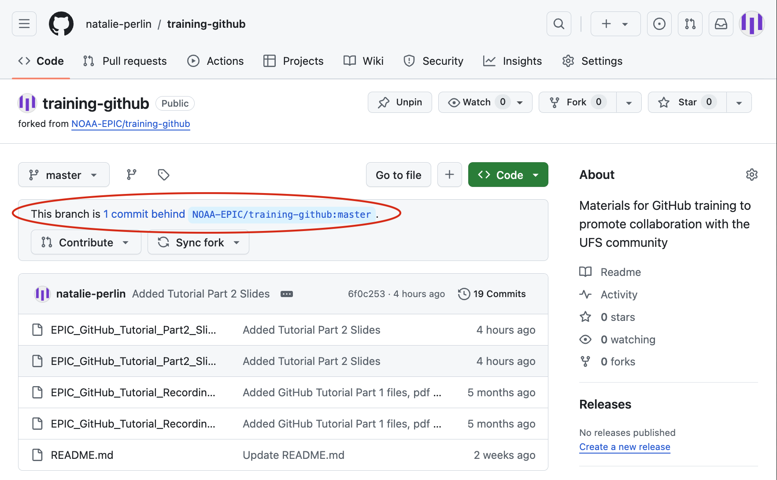
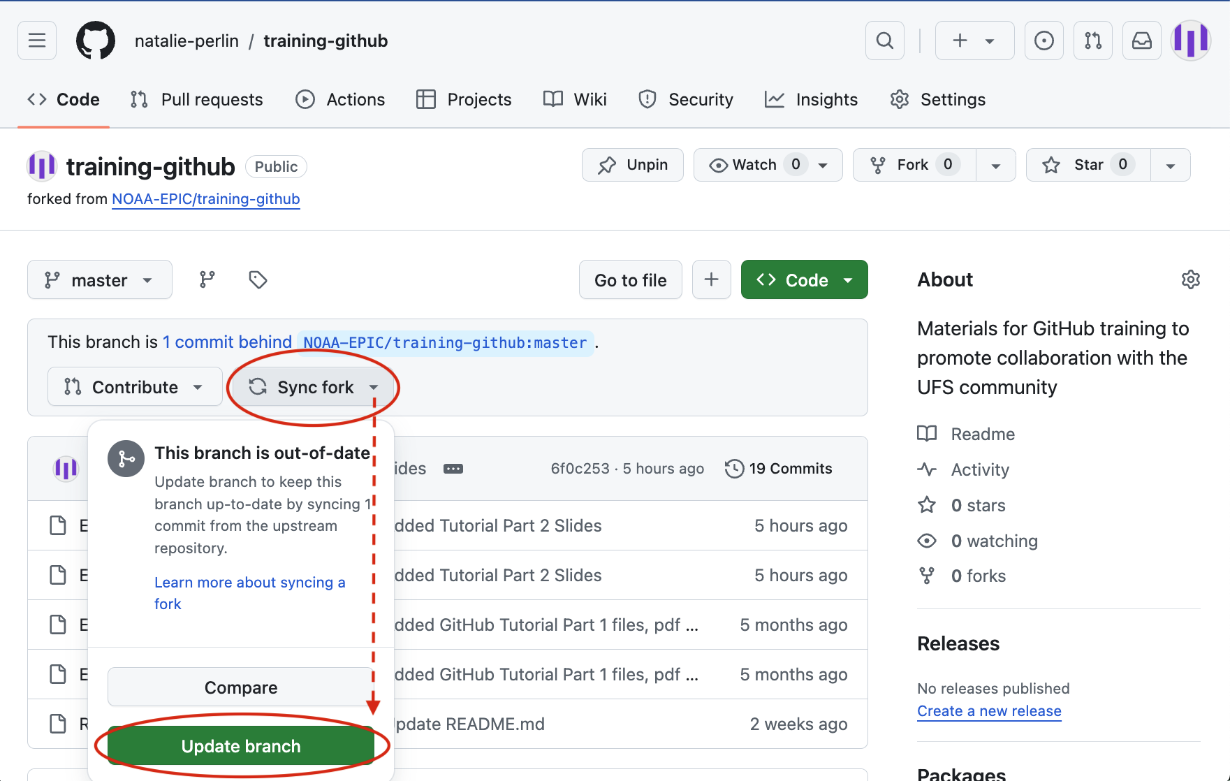
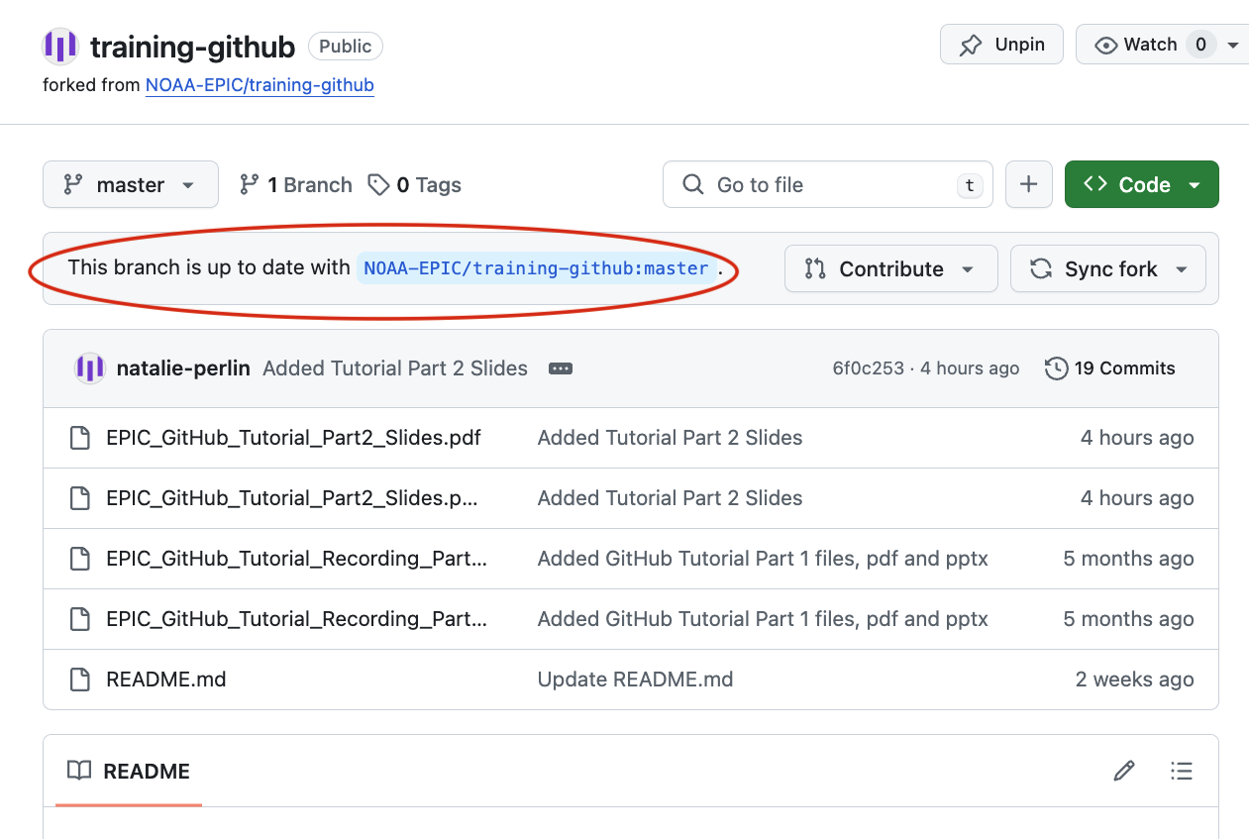
Local repository: keep it synched with the remote!
An existing authoritative repository: https://github.com/NOAA-EPIC/training-github
Remember to sync your primary (master) branch with that from the original repo!
EARTH PREDICTION INNOVATION CENTER (EPIC)

Slide 25
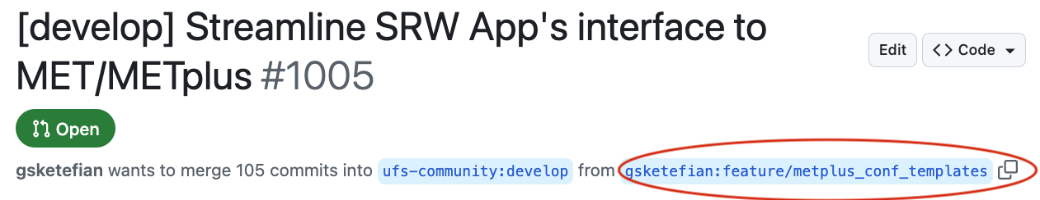
Git workflow example: testing another user’s pull request (PR)
git clone git@github.com:<user-fork>/ufs-srweather-app.git
cd ufs-srweather-app
git remote add upstream git@github.com:ufs-community/ufs-srweather-app.git
# checkout a specific PR from the upstream branch:
git pull upstream pull/<PR#>/head:PRtest
git checkout PRtest
# Test the PR, build, run the code # Comment on the PR on specific issues, files, or specific lines
# Make your own pull request into original PR-author’s repository to suggesting your own changes
EARTH PREDICTION INNOVATION CENTER (EPIC)

Slide 26
Git workflow example: testing another user’s pull request (PR)
git clone git@github.com:<user-fork>/ufs-srweather-app.git
cd ufs-srweather-app
git remote add upstream git@github.com:ufs-community/ufs-srweather-app.git
# checkout a specific PR from the upstream branch:
git pull upstream pull/<PR#>/head:PRtest
git checkout PRtest
# Test the PR, build, run the code # Comment on the PR on specific issues, files, or specific lines
# Make your own pull request into original PR-author’s repository to suggesting your own changes
EARTH PREDICTION INNOVATION CENTER (EPIC)

Slide 27
Repositories with submodules or external dependencies
Check out a few different repositories with submodules:
git clone --recursive <url-repo>
git clone --recurse-submodules <url-repo>
git clone <url-repo> cd <repo> git submodule update –remote
git clone --recurse-submodules https://github.com/jcsda/spack-stack.git
git clone --recursive https://github.com/ufs-community/ufs-weather-model.git
EARTH PREDICTION INNOVATION CENTER (EPIC)

Slide 28
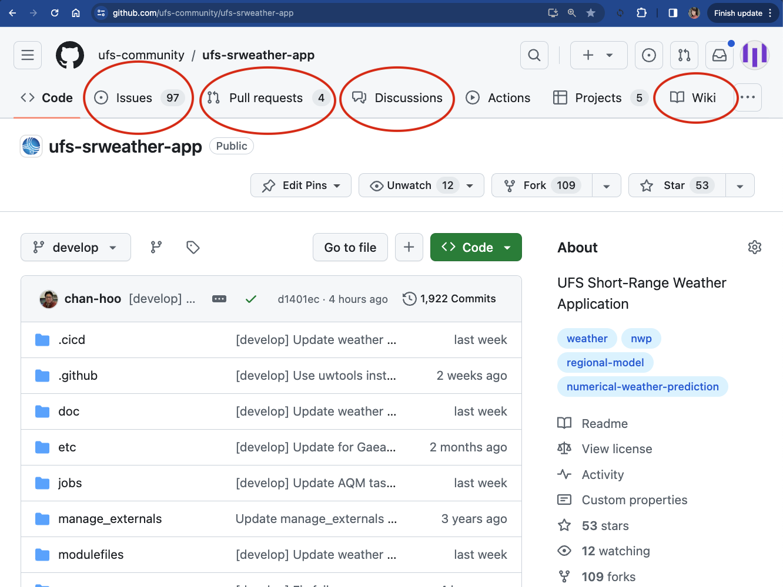
Perusing Public Repositories
Submitting issues - “Issues”
Reaching out for help through discussions - “Discussions”
Checking out and testing existing PRs -
“Pull Requests”
Navigating documentation - “Wiki”, look for links to readthedocs.io, such as
https://ufs-weather-model.readthedocs.io/ https://ufs-srweather-app.readthedocs.io/
EARTH PREDICTION INNOVATION CENTER (EPIC)

Slide 29
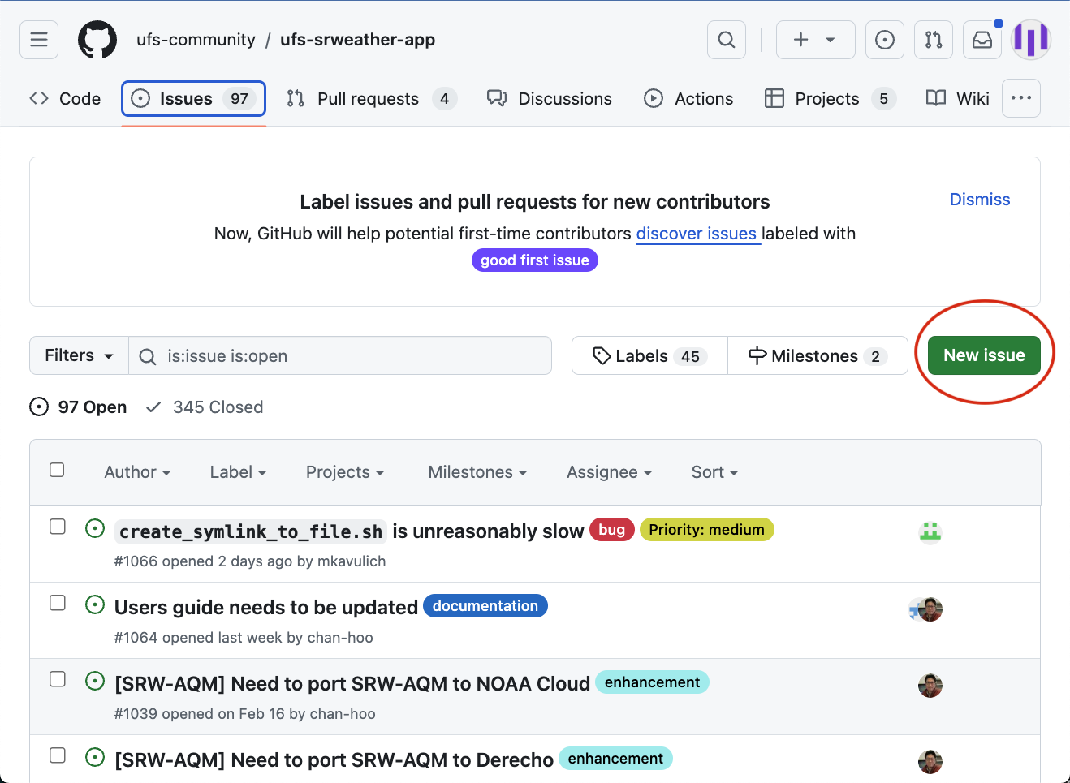
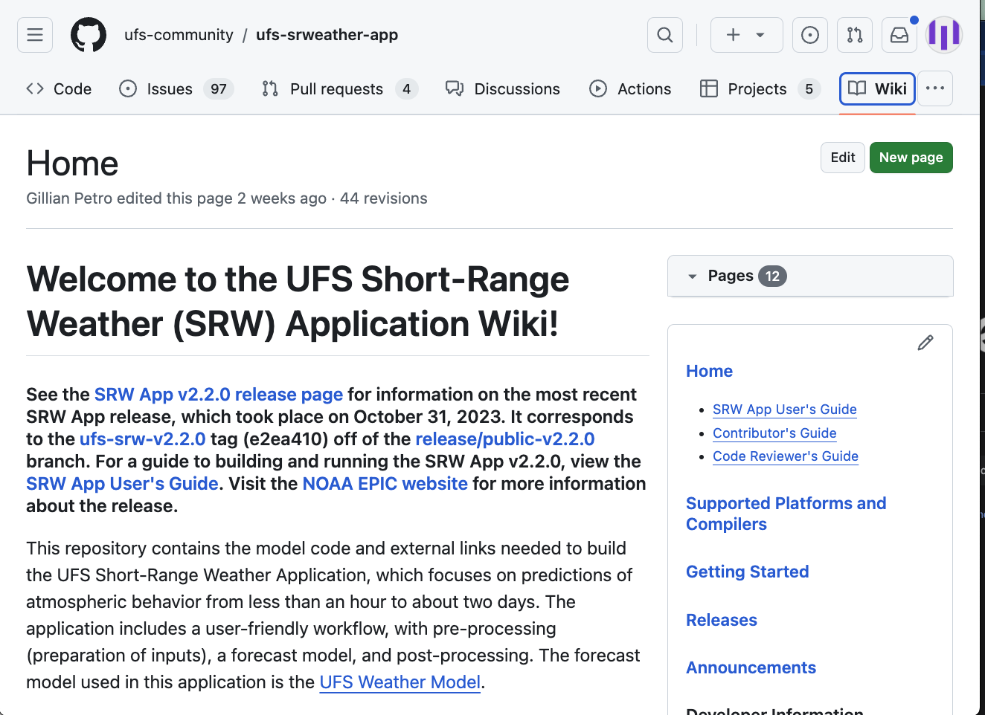
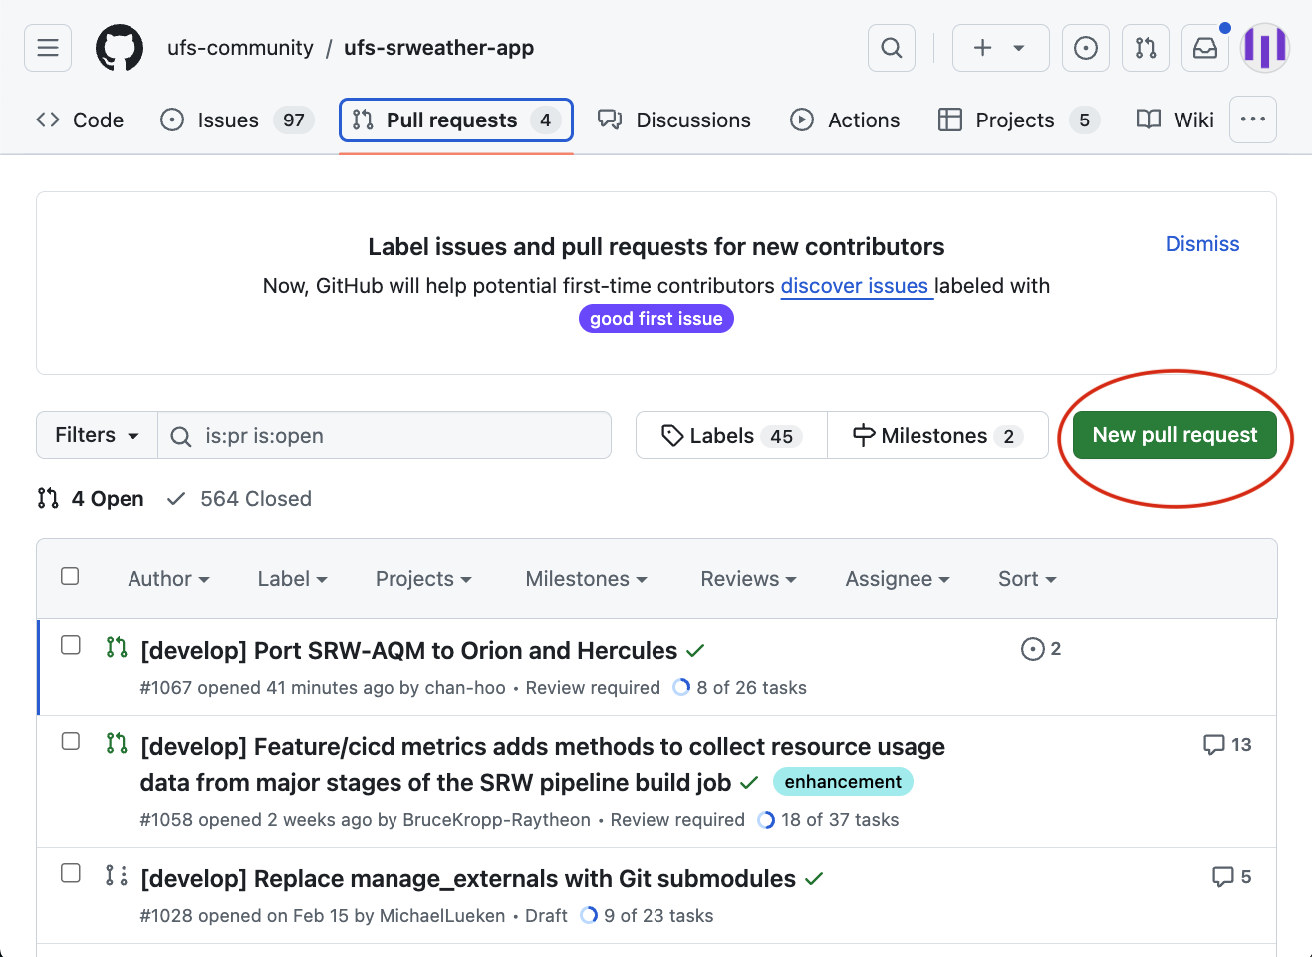
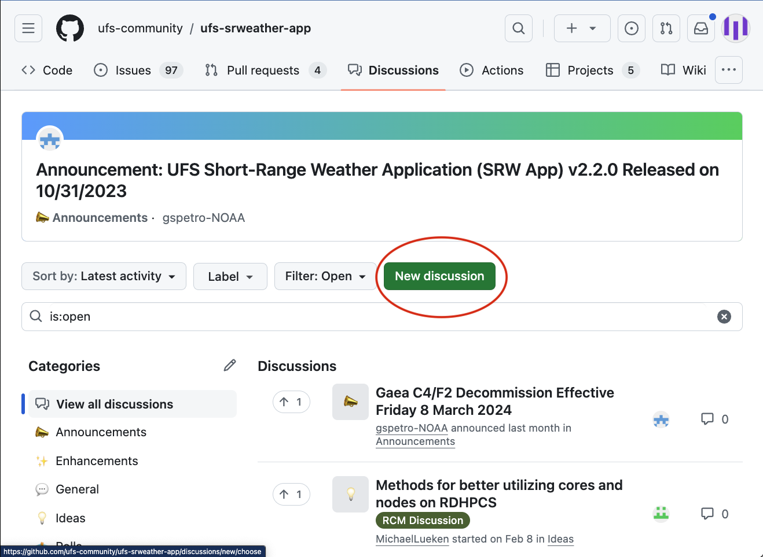
Perusing Public Repositories
EARTH PREDICTION INNOVATION CENTER (EPIC)

Slide 30
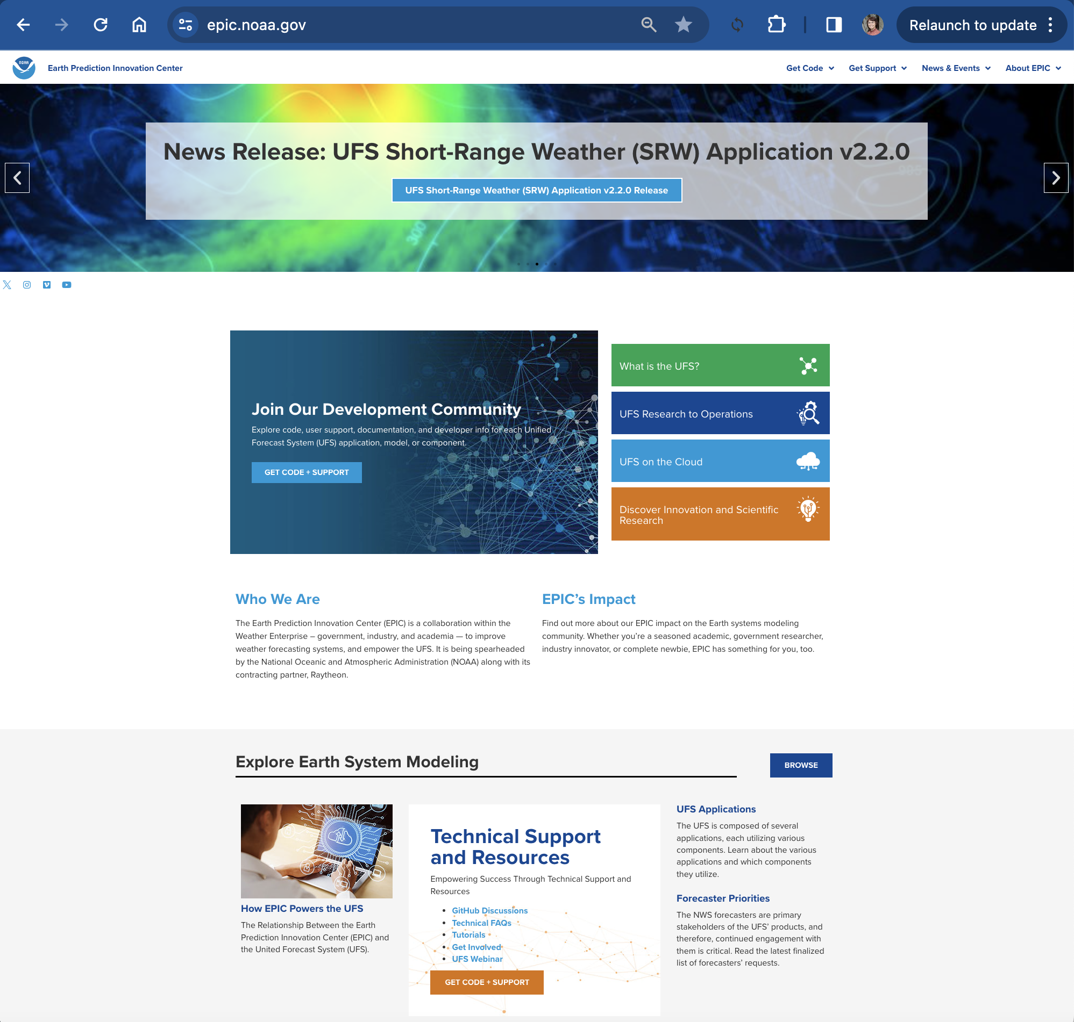
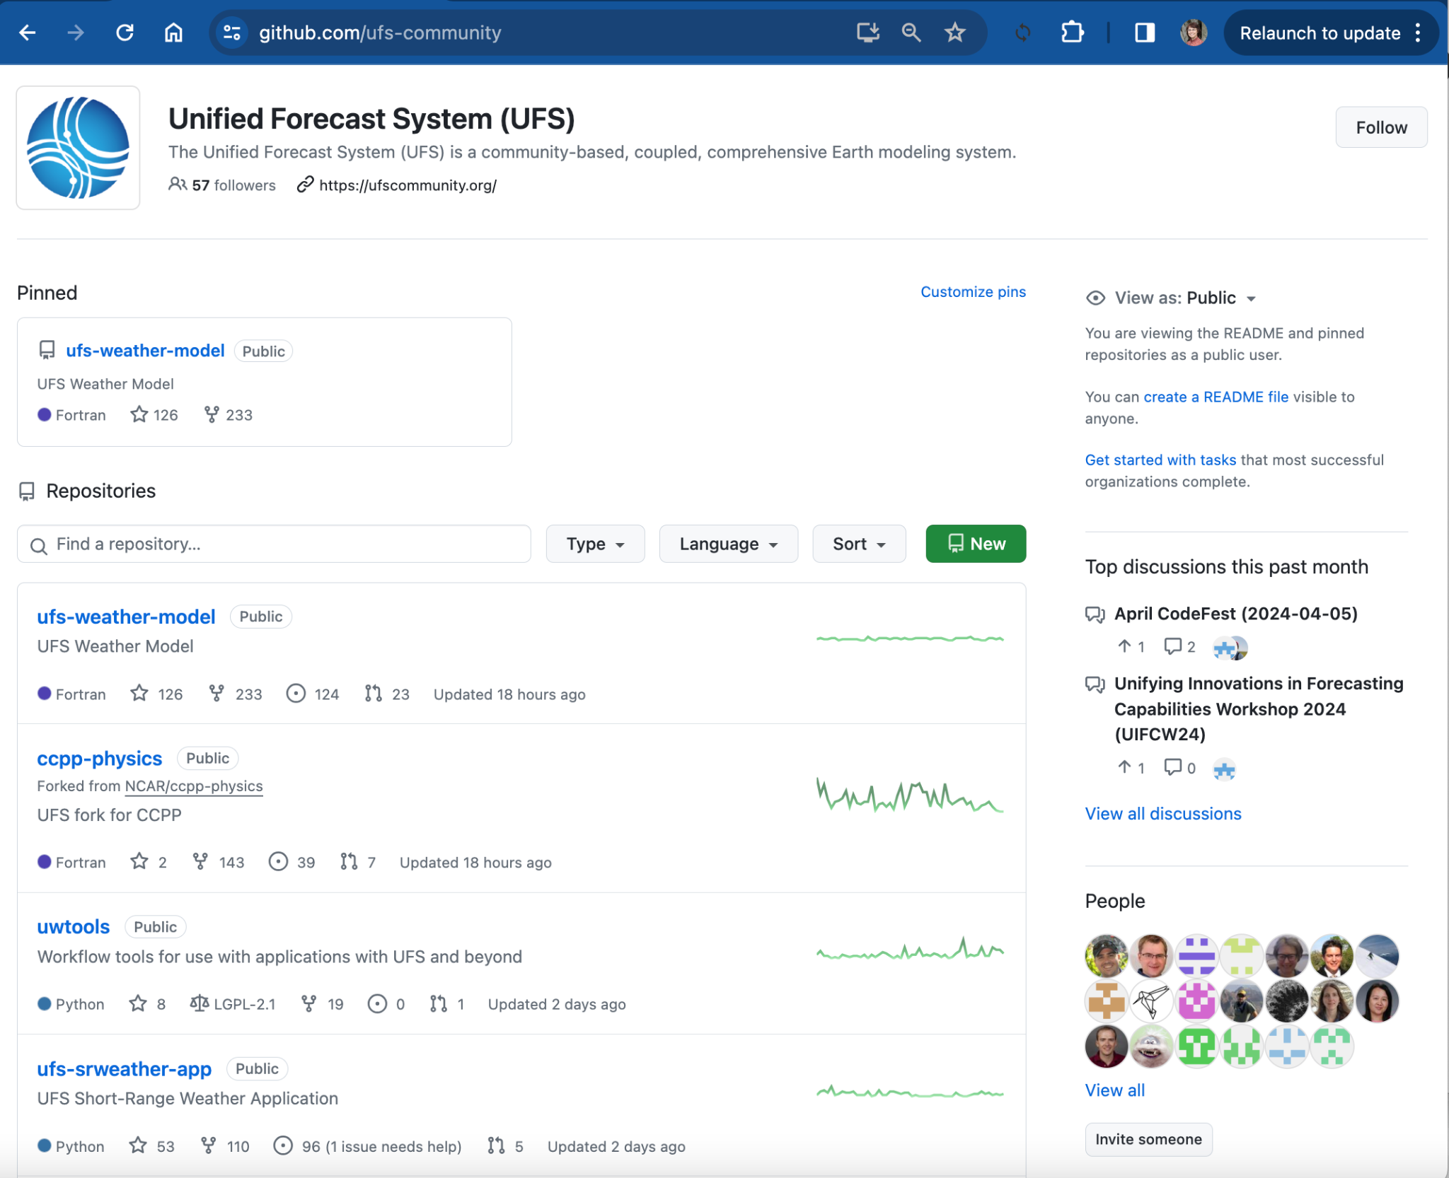
Happy Modeling and Contributing to UFS!
https://epic.noaa.gov/
https://github.com/ufs-community
EARTH PREDICTION INNOVATION CENTER (EPIC)

